Slide 1
Java – Hands On
Career Craft Academy

Slide 2
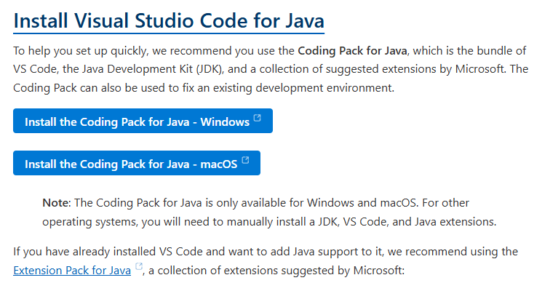
Install VS Code with Java
https://code.visualstudio.com/docs/languages/java

Slide 3
Java Fundamentals And Project Setup
JDK, JRE, JVM, Compilation and Execution
main method, variables, data types and operators.
if, switch, loops and console output
Create the project and display the library menu.

Slide 4
Java Program Structure
Workspace Folder
Java Project
Java Package
Java Class{
Data Type variable1;
Data Type variable2;
Data Type variableN;
Method1(){
statement1;
statement2;
statementN;
}
Method2(){}
MethodN(){}
}

Slide 5
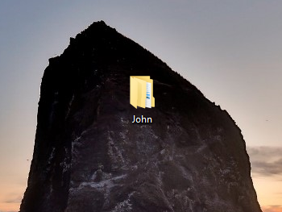
Create Workspace Folder in Desktop

Slide 6

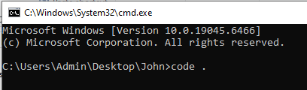
Open Command Prompt from Workspace folder
Open VS Code from Command Prompt

Slide 7

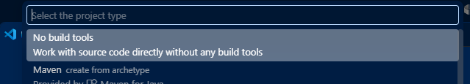
Create New Java Project
Ctrl + Shift + P
No Build Tools

Slide 8
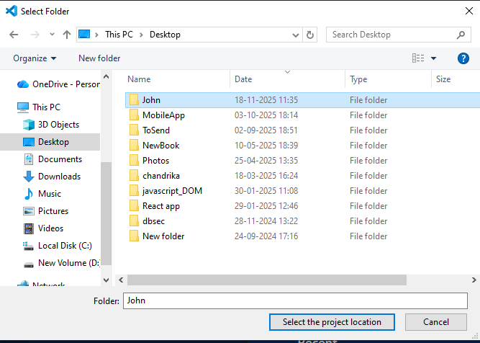
Select Project Location Folder

Slide 9

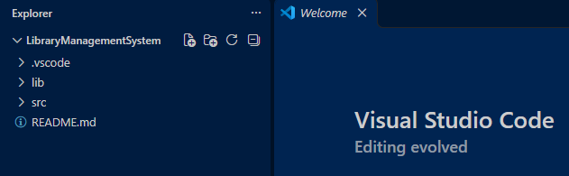
Project Name

Slide 10
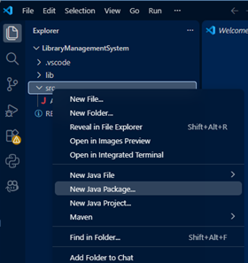

Create Java Package (base)

Slide 11
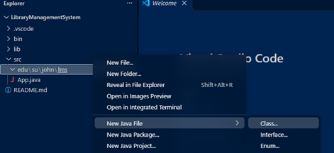

Create Java Class

Slide 12
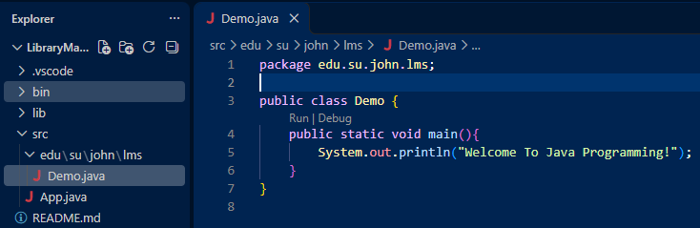
Java Class with main method

Slide 13
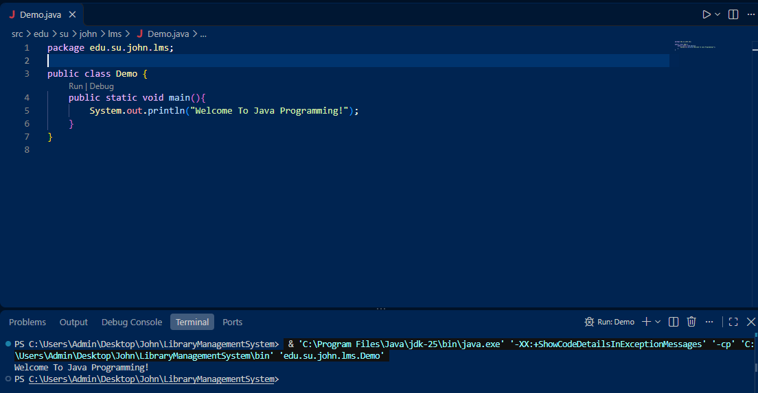
Run and check the output in terminal / console

Slide 14
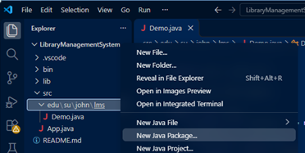

model package

Slide 15
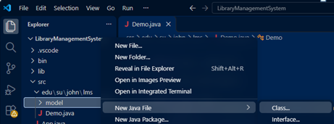

create class Book

Slide 16
class Book
package edu.su.john.lms.model;
public class Book {
public int id;
public String title;
public String author;
public String category;
public Double price;
public int totalCopies;
public int availableCopies;
}

Slide 17
class Demo
Create 3 book objects.
Set values for 3 books.
Print heading
Get 3 book values and print as rows.

Slide 18
class Demo - Formatted output
Use System.out.printf to format the output.

Slide 19
class Book - Access Specifiers – Public and Private
Change all public properties to private properties in class Book.
Generate Getters and Setters.

Slide 20
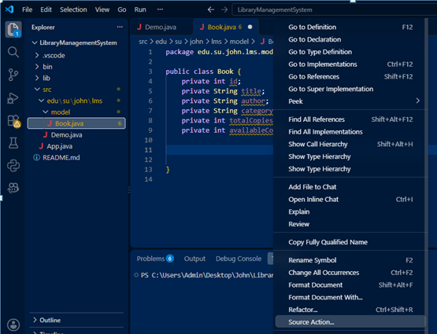
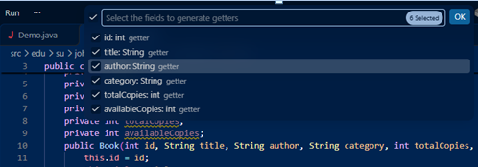
Right Click –> Source Action -> Generate Getters & Setters -> Select All

Slide 21
class Demo - main method
Modify program by using setters and getters.
Run the program.

Slide 22
class Book – toString()
Right click -> Source Action -> Generate toString() -> Ok
Modify the overrided toString method()

Slide 23
class Demo – print objects
Modify the main function.
Run the program.

Slide 24
class Book – static method to print Heading.
Add a static method ‘printHeading’ in class Book.
Call the static method in main method.

Slide 25
class Book – instance method to scan data for object.
Add a new instance method scanBook in class Book.
Call the scanBook method in main method.
Run the program.

Slide 26
Constructors
Right Click -> Source Action -> Generate Constructors. Don’t select Scanner.
Generate Default and Parameterized constructors in class Book.
Modify main method to use book constructors to create objects.
Run the program.

Slide 27
Auto Generation
Create and initialize static member in class Book.
Create parameterized constructor without id and scanner fields.
Both constructors include this.id = nextId++;
Also include in scanBook method.
In the main method, create objects without id.
Run the program.

Slide 28
Array of Objects
Create Book array of size 5 in main method.
Create 5 book objects and assign to each element of the array.
Modify any book object value.
Print heading and print the array of objects.
For Loop – print array of objects

Slide 29
Arraylist
Create a Arraylist Container books.
Create book objects and add to books.
Update any book object in books container.
Delete any book object in books container.
Read all book objects from books container.

Slide 30
HashMap
Create a Hashmap Container books.
Create book objects and add to books.
Update any book object in books container.
Delete any book object in books container.
Read all book objects from books container.

Slide 31
HashSet
Create a HashSet Container books.
Create book objects and add to books.
Update any book object in books container.
Delete any book object in books container.
Read all book objects from books container.

Slide 32
class Student
Create class Student.
Generate toString(), Getters & Setters, Constructors.
Create printHeading function and scanStudent static function.
Implement Auto Increment feature.
In the main method, create Student Objects, update, delete and read all.

Slide 33
Library Menu - class LibraryService
Create a new package service.
Create a new class LibraryService under the package service.
In the main method, call the Library services in repeated menu.
Run the program.

Slide 34
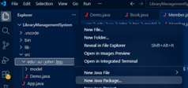

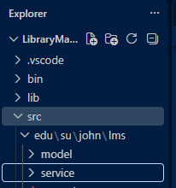
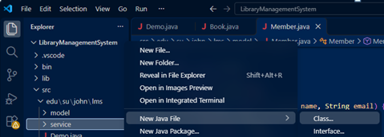

class LibraryService
package service

Slide 35
List, Add and Search Books
Implement the display, add and search books functionalities in class LibraryService.
Run the program and test those methods.

Slide 36
List, Add and Search Students
Implement the display, add and search students functionalities in class LibraryService.
Run the program and test those methods.

